Slide 1
DOM
(Document Object Model)

Slide 2
The DOM (Document Object Model)
The Document Object Model (DOM) is a structured representation of the HTML document as an object tree.
Each HTML element is an object, and JavaScript can interact with these objects to modify the page's content.
The DOM is not a programming language, but without it, the JavaScript language wouldn't have any model or notion of web pages or HTML documents
The DOM provides a structured representation of HTML documents, which allows JavaScript to access and manipulate the content, structure, and style of a webpage.
Notes:
Everything from the page’s doctype to each individual letter in the text can be accessed via the DOM and manipulated with JavaScript.

Slide 3
The DOM (Document Object Model)
Although JavaScript is often used in conjunction with the DOM, the DOM is a separate entity.
The DOM is a Web API (Application Programming Interface),
i.e., it provides a set of methods for developers to interact with and manipulate web documents using programming languages like JavaScript.
Notes:
Everything from the page’s doctype to each individual letter in the text can be accessed via the DOM and manipulated with JavaScript.

Slide 4
Cont’d
The DOM:
provides a structured map of the document
can be accessed by other programming languages like Python, PHP, C++, java
provides a programming interface for HTML
I.e. provides a standardized set of methods through which JavaScript (and other programming languages) can interact with the elements on a page
JavaScript uses the DOM to access the document and its elements
Changes in the DOM reflect instantly on the webpage

Slide 5
This tree of objects, or nodes, representing the page's content is called the DOM.
html
head
title
body
h1
p
script
html
head
title
body
h1
p
script
The browser parses the HTML and creates a tree of objects like this:

Slide 6
Accessing Elements
DOM methods allow you to access element nodes by ID, tag name, and class name
HTML DOM methods are actions you can perform (on HTML Elements).
getElementById(): uses “id” to find an element
getElementsByTagName(): uses “tag name” to find an element
getElementsByClassName(): uses “class name” to find an element
If you want to access any element in an HTML page, you always start by accessing the document object.
document.getElementById(id)
document.getElementsByTagName(name)
document.getElementsByClassName(name)
Notes:
JavaScript uses the DOM to access the document and its elements

Slide 7
Accessing elements
Additional methods for accessing nodes in the document,
document.querySelector('selector'): to select the first element that matches a specified CSS selector.
Example, var element = document.querySelector('#myElement .myClass');
document.querySelectorAll('selector') to select all elements that match a specified CSS selector.
Example, var elements = document.querySelectorAll('.myClass');

Slide 8
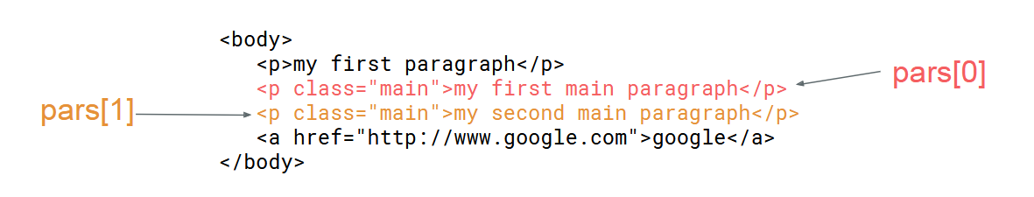
Accessing elements
querySelectorAll() method will return a list of all HTML elements that match the specified CSS query.
const pars = document.querySelectorAll("p.main");

Slide 9
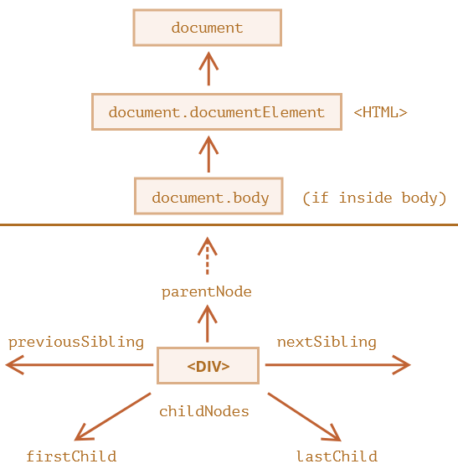
Accessing Elements via DOM Traversing
All operations on the DOM start with the document object. That’s the main “entry point” to DOM.
DOM traversing refers to navigating through elements and their relationships in the HTML document.
It allows you to select elements dynamically based on their hierarchy and relationships.

Slide 10

Parent Relationships
.parentNode → Selects the parent of an element.
const parent = document.querySelector('.child').parentNode;
console.log(parent.className); // Output: parent

Slide 11
Parent Relationships
.closest(selector) → Finds the closest ancestor matching the selector.
const closestParent = document.querySelector('.child').closest('.parent');
console.log(closestParent.className); // Output: parent

Slide 12
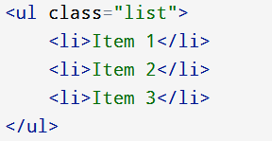
Child Relationships
.children → Returns an HTMLCollection of child elements.
const children = document.querySelector('.list').children;
console.log(children.length); // Output: 3

Slide 13
Child Relationships
.firstElementChild → Selects the first child element
const firstChild = document.querySelector('.list').firstElementChild;
console.log(firstChild.textContent); // Output: Item 1

Slide 14
Child Relationships
.lastElementChild → Selects the last child element.
const lastChild = document.querySelector('.list').lastElementChild;
console.log(lastChild.textContent); // Output: Item 3

Slide 15

Sibling Relationships
.nextElementSibling → Selects the next sibling element.
.previousElementSibling → Selects the previous sibling element.
const nextSibling = document.querySelector('.box').nextElementSibling;
console.log(nextSibling.textContent); // Output: Box 2
console.log(prevSibling.textContent); //null

Slide 16
Takeaway Questions
When would you use .parentNode instead of .closest()?
How would you select all ‘li’ elements within a specific ul tag using DOM traversing methods?
Given the following HTML, Write a script to count and log the number of child elements inside the <div> with id="content”
<div id="content"> <p>Paragraph 1</p> <p>Paragraph 2</p> <p>Paragraph 3</p> </div>

Slide 17
4. What will be the output of the following script?
Given the following HTML:
What will be the output of the following script?
console.log(document.getElementById("child").parentElement.parentElement);
<div id="grandparent"> <div id="parent"> <p id="child">Child Element</p> </div> </div>
Notes:
t will display the entire <div id="grandparent"> element, including its children.

Slide 18
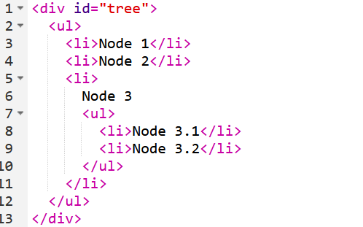
5. What will be the output
let node = document.querySelector("li:nth-child(3)");
console.log(node.parentElement);
console.log(node.nextElementSibling);
console.log(node.querySelector("ul").children);
Notes:
<ul>...</ul>
null
<li>Node 3.1</li>
<li>Node 3.2</li>

Slide 19
DOM Manipulation

Slide 20
Manipulating Elements
Once you have accessed the elements, you can either change the content, attribute or style as you wish.
element.innerHTML = new html content
Changes the inner HTML of an element
element.textContent = new value
Changes the text content of an element
element.attribute = new value
Changes the attribute value of an HTML element
element.style.property = new style
Changes the style of an HTML element

Slide 21
Example,
<html> <body> <p id="demo"></p> <script> document.getElementById("demo").innerHTML = "Hello World!"; </script> </body> </html>

Slide 22
Example,
<html> <body> <p id="p2">Hello World!</p> <script> document.getElementById("p2").style.color = "blue"; </script> </body> </html>

Slide 23
Takeaway question
Write a JavaScript code to change the color of a paragraph with ID "myParagraph" to "blue".
Write a JavaScript code to update the text content of an element with the ID "myText" to "Hello, World!".
Write a JavaScript function that takes an id as a parameter and returns the text content of the element with that id using getElementById().
Write a function that takes a CSS selector as an argument and returns the text content of the the first paragraph element within a div

Slide 24
Dynamically creating and appending elements
The DOM also allows us to change the document structure itself by creating and adding new nodes on the fly.
The methods shown here are more precise than adding content with “innerHTML”
Step 1: Create the element
Step 2: Set attributes, styles, or content for the newly created element
Step 3: Identify the parent element where you want to append the new element. (This could be an existing element in the DOM)
Step 4: Append the Element to the Parent Node

Slide 25
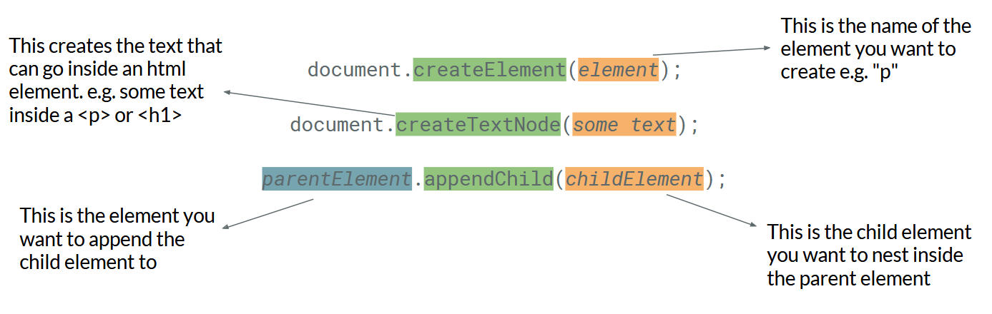
Adding HTML Elements

Slide 26
Takeaway question
Create a new <div> element and append it to the body of your HTML document?
Create and append an unordered list (<ul>) to a div with the id "myListContainer," and then add 2 list items (<li>) with the content "Item 1," and "Item 2" to that unordered list

Slide 27
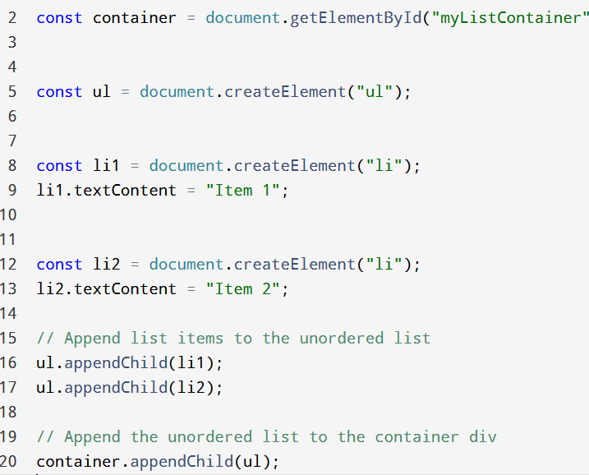

Slide 28
Removing HTML Elements
Removing Child Nodes
parentNode.removeChild(childNode) is a method to remove a child node from its parent.
Example: element.parentNode.removeChild(element);
Deleting Elements
element.remove() is an alternative method to remove an element directly.
Example: element.remove();

Slide 29
Form Validation

Slide 30
Form Validation
Before submitting data to the server, it is important to ensure all required form controls are filled out, in the correct format.
This is called client-side form validation, and helps ensure data submitted matches the requirements set forth in the various form controls
By catching invalid data on the client-side, the user can fix it straight away.
HTML form validation can be done by JavaScript.

Slide 31
For example, if you don't enter your data in the format that is expected in a registration form. You get messages such as:
"This field is required"
"Please enter your phone number in the format xxx-xxxx"
"Please enter a valid email address"
"Your password needs to be between 8 and 30 characters long and contain one uppercase letter, one symbol, and a number.”

Slide 32
Typical validation tasks are:
has the user filled in all required fields?
has the user entered a valid date?
has the user entered text in a numeric field?

Slide 33
Different types of client-side validation
There are two different types of client-side validation that you'll encounter on the web:
Built-in form validation uses HTML form validation features.
<form action="/action_page.php" method="post">
<input type="text" name="fname" required|readonly|disabled>
<input type="submit" value="Submit">
</form>
JavaScript validation is coded using JavaScript.

Slide 34
Example- Form Validation using JavaScript
<form name="myForm">
<input type="text“ name="fname"/>
<p id="fnameId"></p>
<input type="text" name="lname"/>
<button type="button" onclick="myFunction()">Click me! </button>
</form>
if (document.myForm.fname.value ==""){
alert("please try again");
return false;
}
Notes:
Form elements like input, textarea and select have “value” property that represents the current value of the form control
Example, var text=document.getElementById(“usernameInput”).value;

Slide 35
Giving input fields a required length of between 5 and 20 characters
<form name="commentForm">
<input type="text" placeholder="username" name="username"/><br>
<p id="userId"></p>
<input type="tel" placeholder="phone number" name="phone"/><br>
<textarea name="comment" row="4" cols="25">comments</textarea>
<button type="button" onclick="myFunction()">click me</button>
</form>

Slide 36
function myFunction(){
const username=document.commentForm.username.value;
if (username.length<5 || username.length>12){
document.getElementById("userId").innerHTML="* Usernames are required to be between 5 and 20 characters";
document.getElementById("userId").style.color="red";
return false;
}

Slide 37
Giving input fields a maximum length of “x” characters
<form name="commentForm">
<input type="text" placeholder="username" name="username"/><br>
<p id="userId"></p>
<input type="tel" placeholder="phone number" name="phone"/><br>
<textarea id =“comment” name="comment" row="4" cols="25">comments</textarea>
<button type="button" onclick="myFunction()">click me</button>
</form>

Slide 38
function myFunction(){
const comment=document.commentForm.comment.value;
if (comment.length>201){
document.getElementById(“comment").innerHTML="* Comments can’t be longer that 200 characters";
document.getElementById(“comment").style.color="red";
return false;
}

Slide 39
Event Handling in JavaScript

Slide 40
Events and Events Handling
Events are generated by the browser when "things happen" to HTML elements:
An element is clicked on, the page has loaded, input fields are changed, HTML form is submitted, a user strokes a key
Event handling in web development involves responding to user actions (events)
Event handling is a crucial aspect of creating dynamic and interactive web applications.
In JavaScript, event handling is typically achieved through the use of event listeners.

Slide 41
Basic terminologies
Events
Events are occurrences that happen in the browser, triggered by user actions or by the browser itself (e.g., page load, resizing).
Event Handlers
Event handlers are functions that respond to specific events. They define what should happen when an event occurs.
Event Listeners
Event listeners are functions that "listen" for a specific event on a particular HTML element. When the event occurs, the associated event handler is executed.

Slide 42
Event list
Mouse Events
Onclick - occurs when the user clicks on an element.
Ondblclick - occurs when the user double-clicks on an element.
Onmousedown - occurs when the user presses a mouse button over an element.
Onmouseenter - occurs when the pointer is moved onto an element.
onmouseleave - occurs when the pointer is moved out of an element.
onmouseover - occurs when the pointer is moved onto an element, or onto one of its children.
onmouseup - occurs when a user releases a mouse button over an element.

Slide 43
Cont.….
Keyboard Events
Onkeydown - occurs when the user is pressing a key.
Onkeypress - occurs when the user presses a key.
Onkeyup - occurs when the user releases a key.
Form Events
Onblur - occurs when an element loses focus.
Onchange - occurs when the content of a form element, the selection, or the checked state have changed (for <input>, <select>, and <textarea>)
Onfocus - occurs when an element gets focus.
Onreset - occurs when a form is reset.
Onsubmit - occurs when a form is submitted.

Slide 44
HTML Event Attributes
A JavaScript code can be executed when an event occurs, like when a user clicks on an HTML element.
For example, to execute a code when a user clicks on a paragraph element, we can use event attributes such as onclick, ondblclick, onSubmit etc…
<p onclick=“myFunction()">Click on this text!</p>
<button ondblclick="displayDate()">Try it</button>

Slide 45
HTML DOM EventListener
Syntax: element.addEventListener(event, function);
The first parameter is the type of the event (such as, "click" or "mousedown" or any other HTML DOM Event.)
The second parameter is the function we want to call when the event occurs.
The addEventListener() method attaches an event handler to the specified element.
The addEventListener() method attaches an event handler to an element without overwriting existing event handlers.
You can add many event handlers to one element.
You can add many event handlers of the same type to one element, i.e two "click" events.

Slide 46
Example
<button id="myBtn">Try it</button>
<script>
document.getElementById("myBtn").addEventListener("click", myFunction);
function myFunction() {
alert ("Hello World!");
}
</script>

Slide 47
Takeaway questions
What is the difference between using addEventListener and assigning an event directly to an HTML element, such as onclick?
How would you attach a click event to multiple elements with the same class (“blue-button”) in JavaScript?
Write a JavaScript program to create a dropdown menu that shows and hides its options when clicked.
Write a JavaScript function which takes element ID and a string as parameters and changes the background color of an element when a mouse enters it.

Slide 48
Event Object
When an event happens, the browser creates an event object, puts details into it and passes it as an argument to the handler.
Some properties of event object include:
event.type
A property which returns a string representing the type of the event that was triggered. E.g., “click”
event.currentTarget
Element that handled the event.
event.clientX / event.client
Window-relative coordinates of the cursor, for pointer events.
There are more properties. Many of them depend on the event type:

Slide 49
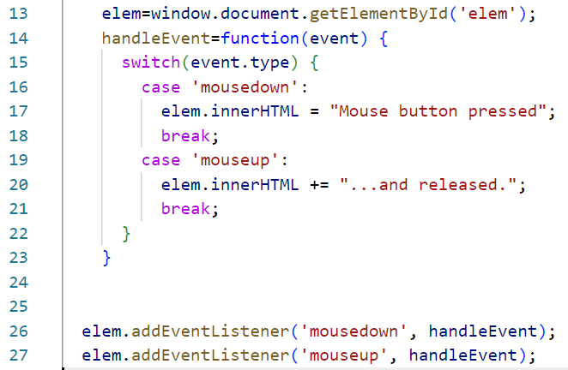
Example

Slide 50
1. Rewrite the following code to use separate event handler methods instead of a single handleEvent function with a switch statement

Slide 51
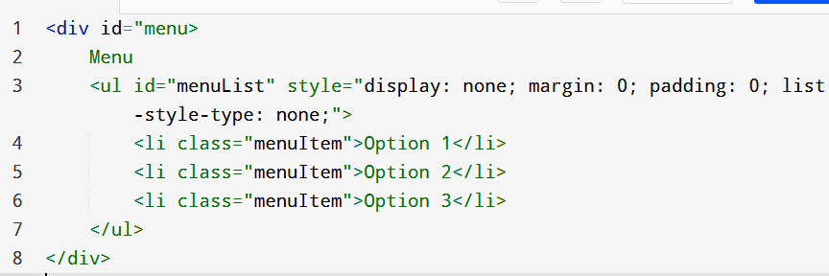
Takeaway exercises
2. Add JavaScript to the button to make <div id="text"> disappear when we click it
4. Add a click event listener to the #menu element to toggle the visibility of the dropdown menu (#menuList).
5. Add a click event listener to the .menuItem elements that logs the selected option's text
Notes:
Expected Behavior:
Clicking on "Menu" toggles the dropdown menu.
Clicking on a menu item logs the selected option.
Unintended Behavior:
Clicking on a menu item also toggles the menu because the click event on the #menu element bubbles up after the menu item's event.

Slide 52
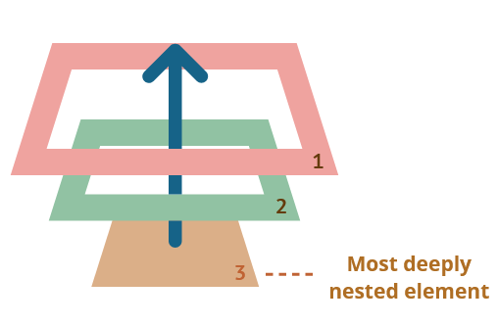
Bubbling
Bubbling occurs when an event happens on an element, it first runs the handlers on it, then on its parent, then all the way up on other ancestors.
The most deeply nested element that caused the event is called a target element, accessible as event.target
Note the differences from (event.currentTarget): the “current” element, the one that has a currently running handler on it.
Notes:
Let’s see what happens when you add an event listener to a parent element, and the user clicks the child element.

Slide 53
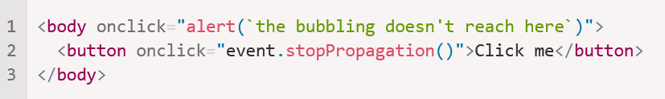
Stopping Bubbling
A bubbling event goes from the target element straight up. Normally it goes upwards till <html>, and then to document object, and some events even reach window, calling all handlers on the path.
But any handler may decide that the event has been fully processed and stop the bubbling.
The method for it is event.stopPropagation().

Slide 54
6. Add a click event listener to the #menu element to toggle the visibility of the dropdown menu (#menuList).
7. Add a click event listener to the .menuItem elements that logs the selected option's text

Slide 55
event.stopImmediatePropagation()
If an element has multiple event handlers on a single event, then even if one of them stops the bubbling, the other ones still execute.
event.stopPropagation() stops the move upwards, but on the current element all other handlers will run.
To stop the bubbling and prevent handlers on the current element from running, there’s a method event.stopImmediatePropagation().
After it no other handlers execute.

Slide 56
Revision questions
What is the difference between event.target and event.currentTarget ?
Add a text area and display the remaining character count (e.g., "50 characters remaining"). Update the count dynamically as the user types.
Create three buttons, each with a different color. Clicking a button should change the background color of the webpage to match the button's color.
Write a script to log all descendant <li> elements of the <div id="root">

Slide 57
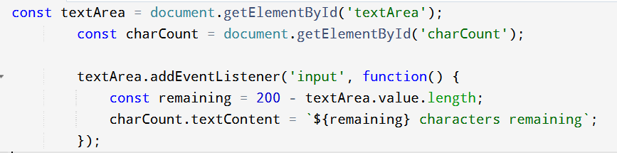
2

Slide 58
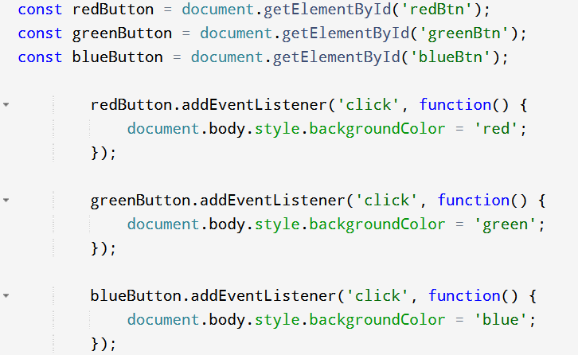
3

Slide 59
Event delegation
A technique in JavaScript where you attach a single event listener to a parent element to manage events for child elements.
Why Use It?
Efficient for handling events on dynamic content.
Reduces memory usage by attaching fewer event listeners.
Simplifies event management in complex applications.
How does it work?
Events bubble up from the target element to the root (document).
By listening on a common ancestor (parent), you can catch events for all children.

Slide 60
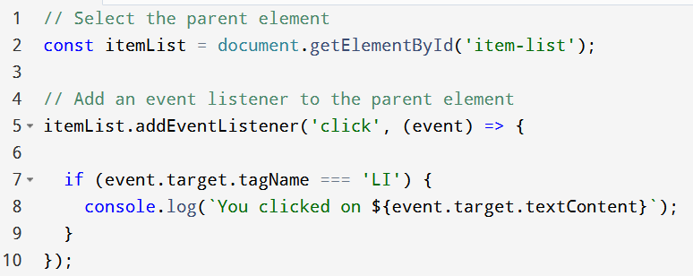
Example,
It is useful when you have multiple elements that require the same event handler or when elements are dynamically added to the DOM.
Imagine you have a list of items, and you want to handle clicks on each list item.
Notes:
Initial Setup: The click event is attached to the <ul> element (the parent).
Event Bubbling: When you click on a <li> element, the event bubbles up to the <ul> element.
Filtering: Inside the event handler, event.target is used to determine if the clicked element is an <li>. If so, the event is processed.

Slide 61
Event delegation
In event delegation, filtering the target element is key to ensuring the correct element triggers the event handler.
Using classList (for specific classes)
event.target.classList.contains('item')
Using id (for specific IDs)
event.target.id === 'specific-item'
Using matches() method (CSS Selector)
event.target.matches('li.item[data-type="special"]')
Using closest() method (for ancestor checks)
event.target.closest('.item')
Notes:
closest() can be used to find the nearest ancestor that matches a selector.
When an event occurs on a child element, filtering allows you to check if the event came from a specific child element (or group of elements) that you care about.

Slide 62
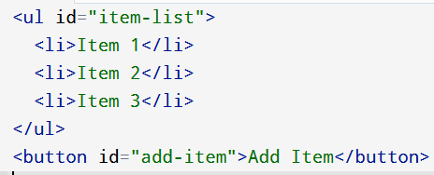
Takeaway Exercise
Write JavaScript code using event delegation to alert the text content of a <li> when it is clicked.

Slide 63
Takeaway Questions
Write a function that listens for click events on any element inside a container with the ID “container”. The function should log "You clicked an image!" when an <img> element is clicked.
Write a function that listens for click events inside a container with the ID “list”. The function should log "You clicked a red item!" when an element with the class “red” is clicked.
Write a function that listens for click events on any element inside a container with the ID “parent”. The function should log "You clicked the special button!" when the element with the ID specialBtn is clicked.

Slide 64
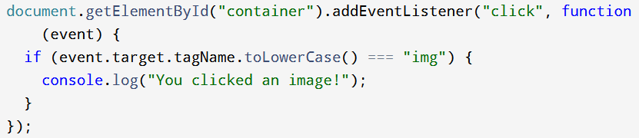
1
Notes:
In HTML, the tagName property returns the name of the element's tag in uppercase

Slide 65
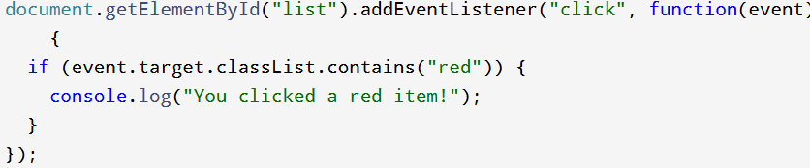
2

Slide 66
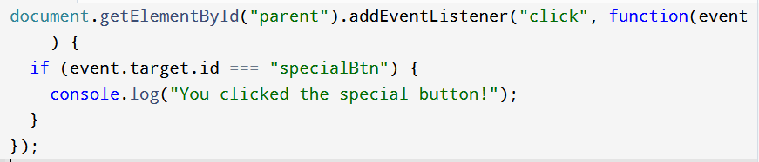
3

Slide 67
Timing Events
With JavaScript, it is possible to execute some code at specified time-intervals. This is called timing events
The two key methods that are used are:
setInterval() - executes a function, over and over again, at specified time intervals
myVar = window.setInterval("javascript function", milliseconds);
There are 1000 milliseconds in one second
window.clearInterval(intervalVariable)
setTimeout() - executes a function, once, after waiting a specified number of milliseconds
myVar = window.setTimeout("javascript function", milliseconds);

Slide 68
End of Chapter 6

